Slide 1
BaF2 Gate Simulations
Bill Worstell
9/11/2018

Slide 2
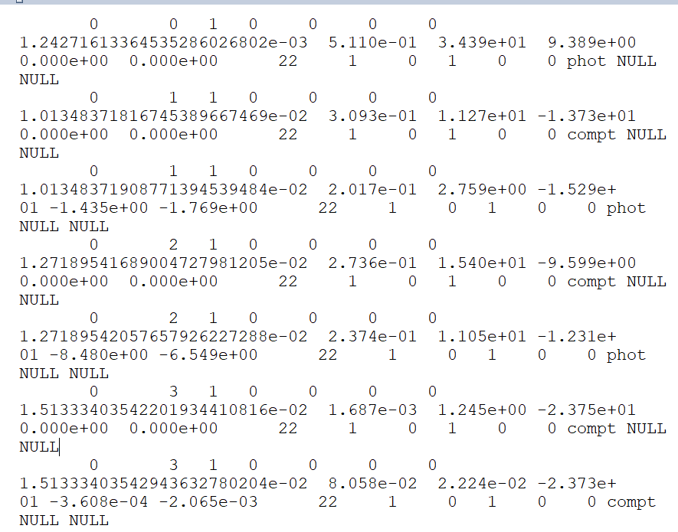
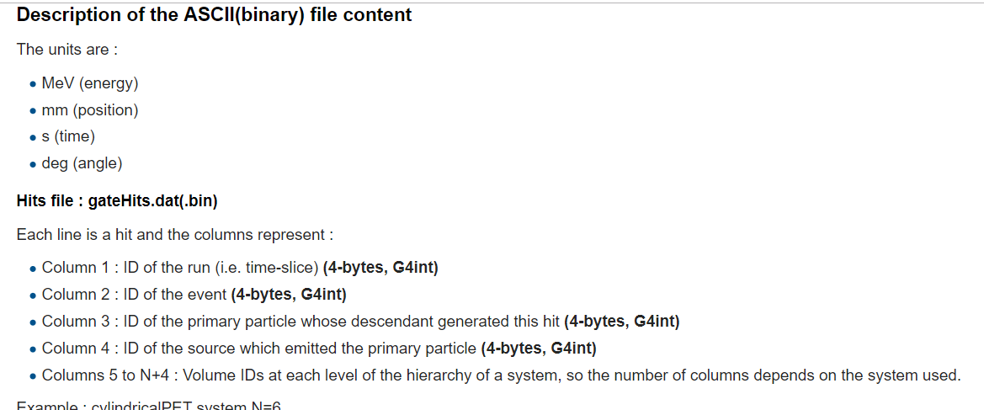
AsciiFileHits.dat Output Format
http://wiki.opengatecollaboration.org/index.php/Users_Guide:Data_output#Description_of_the_ASCII.28binary.29_file_content
Event
Number
Source
ID
Run
Number
Photon
Primary

Slide 3
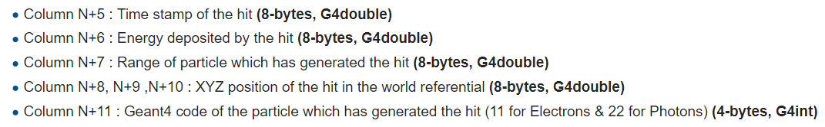
AsciiFileHits.dat Output Format
http://wiki.opengatecollaboration.org/index.php/Users_Guide:Data_output#Description_of_the_ASCII.28binary.29_file_content
http://wiki.opengatecollaboration.org/index.php/Users_Guide:Data_output#Description_of_the_ASCII.28binary.29_file_content
Range of
Secondary
(mm)
Time
Stamp
Energy
Deposited
Event 1: 511keV photocapture
first interaction at (9.4,0.,0.)
Event 2: 309keV Compton
first interaction at (-13.7,0.,0.), 202keV
PC second interaction at (-15.3 -1.4 -1.8)
Event 3: 274keV Compton
first interaction at (-9.6,0.,0.), 237keV
PC second interaction at (-12.3 -8.4 -6.5)

